Slide 1
Java Programming
Intro

Slide 2
What is programming?
Programming is used with almost all electronic devices
Very simply it’s a way to schedule instructions.

Slide 3
Programming Languages
There is different languages used though out the industry. Why?
C++ - Object Oriented Programming, Mid Level
C# - Muti-Paradigm Programming, Mid Level
C – Structure Oriented Programming, Low Level
Java – Object Oriented Programming, High Level
Python – Interpreted Object Oriented Programming, Mid Level
Notes:
Why? Because each language was made to solve a problem for humans. Computers don’t care what they get along they are complied into machine code. The standard for all programming is based off of C++ developed by Bell Labs. Oddly the meaning of C++ is ‘C increment by 1’ an upgrade to C which was built as a general programming language for firmware or portable applications for Unix (AKA Computers).

Slide 4

Programming Languages
Why do we teach Java?
Object oriented
Translatable to more languages (C++ and C#)
Easy to begin with and understand
Used with high level applications (IoT, Enterprise Architecture, and Cloud Computing)
Notes:
Java is object oriented, which means that the user defines the data type to the data structure and the type of operations (aka functions) that can be applied to that data structure. When programmers combine all these functions together you start to build a library that can make some repetitive large code in to a much more easy single line of code.
Java was built off of C++. C# is Similar to Java in capabilities.
Why is this used with high level applications. Let me explain what the levels mean first

Slide 5
Programming Languages
There is different languages used though out the industry. Why?
Low Level – Is a language built to run on the same level as the processer
Mid Level – Is a language built to be portable between processers.
High Level – Is a language built to run as a low and mid level program.
Notes:
Levels are how different the abstraction is from base processing.
Low level is not “portable”. Basically built to the needs of the processer like firmware. The difference between the code between the processers code and the language is low. Thus why its called low level.
Mid Level is portable between processers (Computers). This is your typical applications, games and such.
High Level is built to run on all levels and servers.
That is why java is a high level program. Go back one slide

Slide 6
Programming Languages
Terminology
Compiling - is a process condensing and converting code to a basic level where a computer can understand what the humans are saying they want it to do.
Building – Is a process that saves a code to a target. Built code semi-perminate code and is not protected by the development area.
Flashing – This term is just temporary testing (Debug) code. It allows you to make mistakes without hurting the system. Some other systems my call it debugging mode.
Syntax – Correct order of operations and punctuation.
Object - Defined data type of a data structure and also the types of functions that can be applied to the data structure.

Slide 7
Java basics
Syntax
Data Types and Variables
Arithmetic Methods and Operators
Logical Methods and Operators
Relational Operators
String Methods
Loops
If Else

Slide 8
Java basics
Syntax – Are rules to follow for the program to compile correctly.
Every time you end a command you place a semi-colon ( ; ) at the end.
All functions are followed by round brackets. This is where you pass though information that the function needs to operate. Example: exFunction(“String”);
Any loop or if command will have curly brackets to contain its gated functions.
Correct operators must be used.
Data types can not be crossed but converted.

Slide 9
Java basics
Primitive
Non-Primitive
Integer
Floating Point
char
Classes
byte
float
boolean
Interfaces
short
double
Arrays
int
Strings
long
Data Types
Notes:
Data Types
Primitive data type-are only single values, they have not special capabilities. They are the most basic data types and the building blocks of data manipulation.
Non-Primitive data type – are reference data types. Java creates an address to a value not a value itself.
The main data types we use are…

Slide 10
Java basics
Major Data Types
Integer (int) –Number length spans from -2³¹ to 2³¹ . This is a 32-Bit number value.
Double (double) - This is for decimal numbers. This is a 64-bit IEEE floating point value.
Boolean (boolean) – Only has two values (True or False). This handles only 1 bit.
String (String) – Is a collection of chars. This contains words and letters.
Array (Array[]) – This is a group of like-typed variables. This can be numbers and letters.
Classes (class) – Is a user defined blue print form which objects are created.

Slide 11
Java basics
Arithmetic Methods and Operators
Math.ABS(), Math.SIN(), Math.LOG(), Math.MAX()…
+ (Addition), - (Subtraction), * (Multiplication), / (Division), % (Modulus)
++ (Increment), -- (Decrement)
Use round brackets to set the order you would like math to run. Ex. X=(Y*2)/10
Notes:
These are a few methods of many.
Most of these you know, but im sure you guys are wondering what Modulus is… Well it Divides left-hand operand (Variable Number) by right-hand operand and returns remainder.
Increment is adding 1 to a variable and decrement is subtracting 1 from a variable.

Slide 12
Java basics
Logical Functions
True and False (Aka Boolean)
&& (And), || (Or), ! (Not), ^ (Exclusive Or)
&=, |=, ^= (Assignments)

Slide 13
Java basics
Relational Operators
Comparing Values to one another
< (Less than), > (Greater Than), == (Equal to), != (Not Equal to)
<=(Less than or equal to), >=(Greater than or equal to)

Slide 14
Java basics
String Methods
indexOf(), trim(), concat(), replace(), substring(), isEmpty(), split(), length()
Example:
String mainString = “Hello World”;
String find=“Hello”;
mainString = mainString.substring(find.length()).trim(); //This will output “World”
mainString = mainString.Replace(find, “”).trim(); //This will output “World”
Notes:
As you see there are multiple ways to do things in programming, sometimes there is a shorter way to do things. Lets break down the first example

Slide 15
Java basics
String mainString = “Hello World”;
String find=“Hello”;
mainString = mainString.substring(find.length()).trim();
_____________________________________________________________________________________________________________________
“World” = “Hello World”.( 5 ). Trim();
New Value | Old Value | Start Position | Remove Spaces
The ( . ) declares that a string is going to use a method
Notes:
As you see there are multiple ways to do things in programming, sometimes there is a shorter way to do things. Lets break down the first example

Slide 16
Java basics
Loops
These are the power house of programming. They allow you to do thing over and over tell a condition is met.
While – Built to run tell a condition is met
For – Taking apart arrays or building arrays. Uses a number stop.
Do, While – Will run one once even if the condition is false.

Slide 17
Java basics
While Loops
while(Boolean_expression) {
//Statements
}
while(i == 5) {
//Statements
i++;
}

Slide 18
Java basics
For Loops
for(initialization; termination, increment) {
//Statements
}
for(int i=1; i<11; i++){
//Statements
}

Slide 19
Java basics
Do While
do{ //Statements
i++;
} while(i<=10)

Slide 20
Java basics
If Else Statements
Think of this as a gate and to get pass you have to ask the right question to go in.
Else handles the wrong questions
If(Boolean_Expression) {
//Statements
} else if(Boolean_Expression) {
//Statements
} else {
//Statments
}

Slide 21
Java basics
That’s it for the basics. Now time to program.

Slide 22
Java Programming
Printing and Printing Lines
String Variable, Editing String
Double/Integer Variable, Math
Using Strings and Numbers together
For Loop
Arrays
Building and Array from a For Loop
Taking apart Array from For Loop
End Of Part 1

Slide 23
Java Programming
Open https://www.tutorialspoint.com/compile_java_online.php
This website is a useful tool. It’s an online compiler for not just Java, but almost any programing software out there. You can access this anytime even at home.

Slide 24
Java Programming
Base Structure
public class HelloWorld{
public static void main(String []args){
//Code
}
}

Slide 25
Java Programming
Printing and Printing Lines
This is very useful for debugging and finding out what the software is processing.
One of the most important tools for a programmer.
Difference between print and println is that one will index to the next line the other will add to the existing line
Code:
System.out.print(“Hello World”);
System.out.println(“Hello World”);

Slide 26
Java Programming
String Variable, Editing String
Strings are important for the user to receive feedback from the software.
A lot of programs are just based off of editing strings.
First we are going to create a variable in the same code as before

Slide 27
Java Programming
String Variable
Code:
String nameOfString = “Hello String”;
System.out.println(nameOfString);

Slide 28
Java Programming
String Editing - Replace
Code:
String nameOfString = “Hello String”;
System.out.println(nameOfString);
nameOfString = nameOfString.replace(“String”, “World”);
System.out.println(nameOfString);

Slide 29
Java Programming
String Editing – Adding Two Strings
Code:
String string1 = “Hello”;
String string2 = “World”;
String nameOfString;
string1 = string1 + “ ”;
nameOfString = string1.concat(string2)
System.out.println(nameOfString);

Slide 30
Java Programming
Double/Integer Variable, Math
Math is important in programming. Calculations need to happen and its a lot better for a program to figure stuff out on the fly. Instead of you figuring things out beforehand.

Slide 31
Java Programming
Double/Integer Variable
Code:
double x = 1.5;
int y = 1; double result;
result = x+y;
System.out.println(result);

Slide 32
Java Programming
Using Strings and Numbers together
Code:
String nameOfString = “Hello World”;
nameOfString = nameOfString + “ ” + 20;
System.out.println(nameOfString);

Slide 33
Java Programming
For Loop
Code:
for(int i=1; i<11; i++){
String nameOfString = "Hello World";
nameOfString = nameOfString + " " + i;
System.out.println(nameOfString);
}

Slide 34
Java Programming
Arrays
Code:
//Constent
String[] cars = {"Volvo", "BMW", "Ford", "Mazda"};
//Dynamic
String[] cars;
String buildArray;
buildArray = “Volvo” + “,”;
buildArray = buildArray + “BMW” + “,”;
buildArray = buildArray + “Ford” + “,”;
buildArray = buildArray + “Mazda” + “,”;
cars = buildArray.split(“,”);

Slide 35
Robot Programming – Part 1
What’s it like to be a robot?
RoboRIO
Actuators
Sensors
Operator Control
Drive systems
Communications

Slide 36
Robot Programming – Part 1
What’s it like to be a robot?
A robot is like a blank mind. It has no idea what to do. That’s why we give it tasks to do.
Lets all get up for a group activity.
Notes:
Read first point – A robot will do exactly what you tell it to do, even if your wrong. It could just start spinning because a incorrect value was called. That’s why we test this very carefully. Otherwise people can get hurt or things damaged.
Group activity. Demonstrate different actions of a robot. Simulate different modes that a robot can handle like autonomous and teleop. Besure to use sensory bocks like blindfolds and hearing protection.

Slide 37
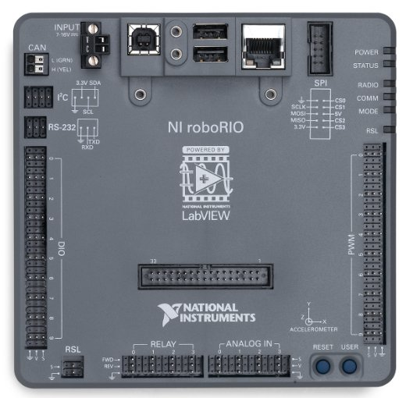
Robot Programming – Part 1
RoboRIO
This is the brains of the robot
Digital I/O
PWM – Pulse Width Modulation, Digitalized Analog
Analog In – Reads variable signals
Relay – A on/off switch
Communications – CAN, I2C, RS-232, SPI, USB, Ethernet
Notes:
CAN – Controller Area Network
I2C - I-squared-C, otherwise known as Integrated Integrated Circuit.
RS-232, Standard Serial Communications
SPI, Serial Peripheral Interface
USB, Universal Serial Bus

Slide 38
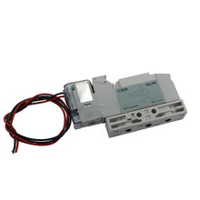
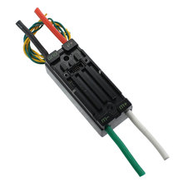
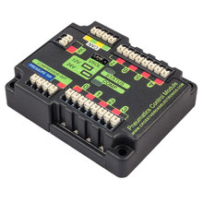
Robot Programming – Part 1
Actuators
These are anything that a robot controls in movement
Motor Controllers, Relays, Solenoids.

Slide 39
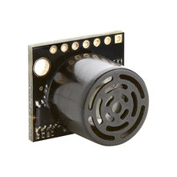
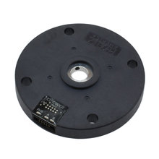
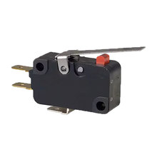
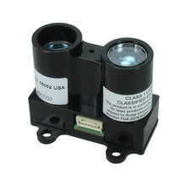

Robot Programming – Part 1
Sensors
These help the robot to be aware of its surroundings
Camera, Ultrasonic Range Finder, Switches, Gyroscopes, Accelerometers, Potentiometers, Encoders, Hall Effect Switch, LIDAR.
Notes:
Light Detection and Ranging

Slide 40
Robot Programming – Part 1
Operator Control
Arcade Control - This mode uses one value to control the throttle (speed along the X-axis) of the drivetrain and one for the rate of rotation.
Tank Control - This mode uses one value each to control the individual sides of the drivetrain.
Omi-Directional Control – For Mecanum and Swerve Drive Systems
Curvature Control - Also known as "Cheesy Drive" this is an alternate way of using one value to control throttle and one value for rotation. The rotation argument controls the curvature of the robot's path rather than its rate of heading change. This makes the robot more controllable at high speeds. Also handles the robot's quick turn functionality - "quick turn" overrides constant-curvature turning for turn-in-place maneuvers.
Notes:
Light Detection and Ranging

Slide 41
Robot Programming – Part 1
Drive Systems
Many different drive systems are built to make the robot maneuver in different ways. We will be brief on these different systems. Most are programmed the same.
Notes:
Light Detection and Ranging

Slide 42
Drive Types: 2 wheel drive
DrivenWheel
Motor(s)
Motor(s)
+ Easy to design
+ Easy to build
+ Light weight
+ Inexpensive
+ Agile
Not much power
Will not do well on ramps
Less able to hold position
Caster

Slide 43
Drive Types: 4 wheel drive, 2 gearboxes
DrivenWheels
Motor(s)
Motor(s)
Chain or belt
+ Easy to design
+ Easy to build
+ Inexpensive
+ Powerful
+ Sturdy and stable
Not agile
Turning is difficult
Adjustments needed
Resource:
Chris Hibner white paper on ChiefDelphi.com
Proves that a wide 4wd drive base can turn easily
DrivenWheels

Slide 44
Drive Types: 4 wheel drive, 4 gearboxes
DrivenWheels
Motor(s)
Motor(s)
+ Easy to design
+ Easy to build
+ Powerful
+ Sturdy and stable
+ Many options
Mecanum, traction
Heavy
Costly
DrivenWheels
Motor(s)
Motor(s)

Slide 45
Drive Types: 6 wheel drive, 2 gearboxes
+ Easy to design
+ Easy to build
+ Powerful
+ Stable
+ Agile*
*2 ways to be agile
Lower contact point on center wheel
Omni wheels on front or back or both
This is the GOLD STANDARD in FRC
+ simple
+ easy
+ fast and powerful
+ agile
Gearbox
Gearbox
Heavy **
Expensive **
** - depending on wheel type

Slide 46
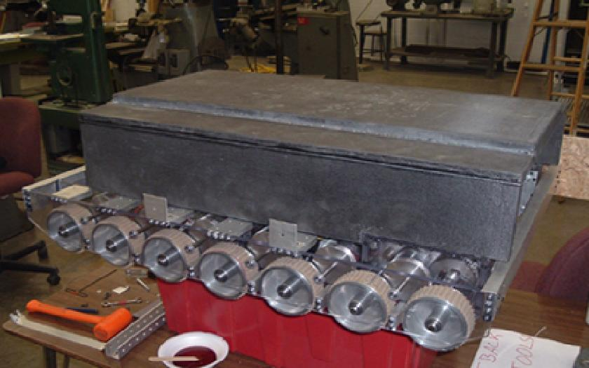
Drive Types: N wheel drive, 2 gearboxes
+ Powerful
+ Stable
+ Agile*
Sole benefit: Ability to go over things
Gearbox
Gearbox
HEAVY
EXPENSIVE
*2 ways to be agile
Lower contact point on center wheel
Omni wheels on front or back or both

Slide 47
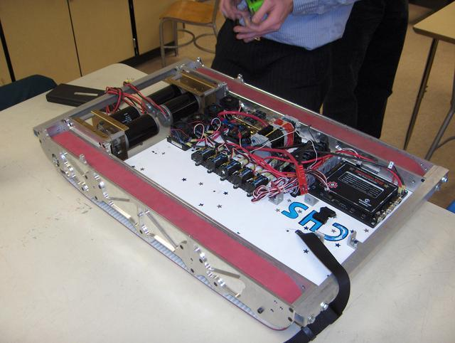
Drive Types: Tank tread drive, 2 gearboxes
Gearbox
Gearbox
+ Powerful
+ VERY Stable
NOT AGILE
HEAVY
Inefficient
EXPENSIVE
Hard to maintain
Sole benefit: Ability to go over things
For turning, lower the contact point on center of track wheel
Will NOT push more than a well-controlled 6wd

Slide 48
Drive Types: 3 wheel
Various types
Lightweight
Fast
Non-standard
(design intensive)
Examples:
16 in 2008
67 in 2005
Gearbox
Gearbox

Slide 49
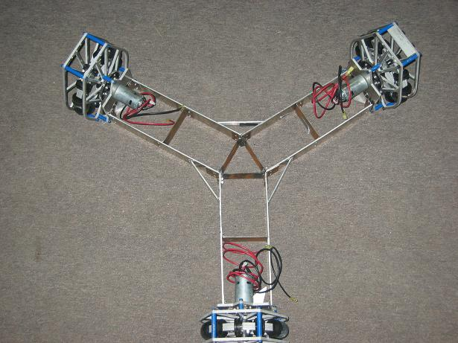
Drive Types: Holonomic - Killough
4 wheel drive or 3 wheel drive
Stephen Killough, 1994
+ Simple Mechanics
+ Immediate Turning
+ Simple Control – 4 wheel independent
No brake
Minimal pushing power
Jittery ride, unless w/ dualies
Incline difficulty

Slide 50
Drive Types: Mecanum
+ Simple mechanisms
+ Immediate turn
+ Simple control – 4 wheel independent
Minimal brake
OK pushing power
Needs a suspension
Difficulty on inclines

Slide 51
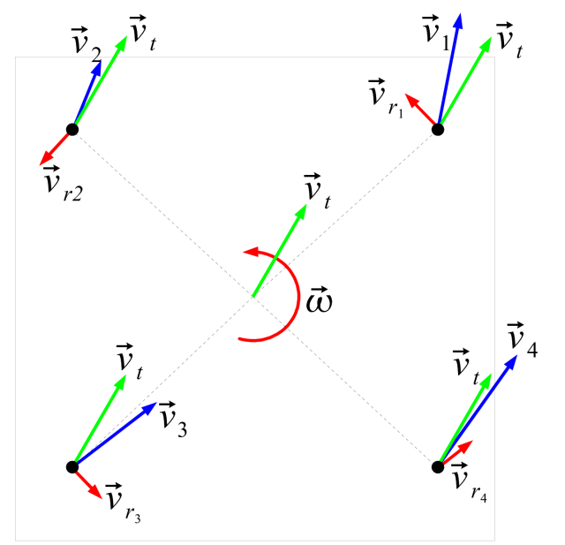
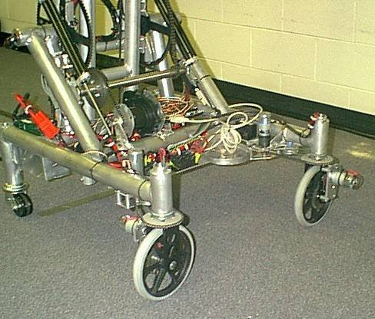
Drive Type: Swerve or crab steering
High-traction wheels
Each wheel rotates to steer
+ No friction losses in wheel-floor interface
+ Ability to push or hold position
+ Simple wheels
Complex system to control and program
Mechanical and control issues
Difficult to drive
Wheel turning delay
Omnidirectional drive systems presentation: http://first.wpi.edu/Workshops/2008CON.html

Slide 52
Robot Programming – Part 1
Communications
For the robot to communicate with the laptop and field we have a Access Point Ethernet Router. Our IP address is 10.8.58.1 . The RoboRIO is 172.22.11.2 .
For a robot to communicate with system, the “Radio” needs to configured using the configuration tool provided by FIRST.
At an event we will need to have it configured by a Field Tech.
Notes:
Light Detection and Ranging

Slide 53
Robot Programming – Part 2
Installing VS Code
Navigating VS Code
Creating a New Project
Robot Classes
Robot Functions
Creating our First Code
Building/Deploying Robot Code
WPI Library Reference

Slide 54
Robot Programming – Part 2
Installing Visual Studio Code
The installation process is very simple. When we install VS Code, the libraries for Java and C++ is installed automatically.
The overall installation is very light and can be done on any PC.
If you want the robot to be controlled; you’ll need to install the NI FRC Suite after installing VS Code.
Please download this software at home as well on the computers you are on. If you need permission form your parents, please ask them.
Download links are on the last sheet of your papers.

Slide 55
Robot Programming – Part 2
Installing Visual Studio Code
Double Click On WPILibInstaller_Windows64-2019.4.1.ZIP
This will open, then
Double Click On WPILibInstaller_Windows64-2019.4.1.exe
Notes:
Have the files already loaded on the computers the students are using

Slide 56
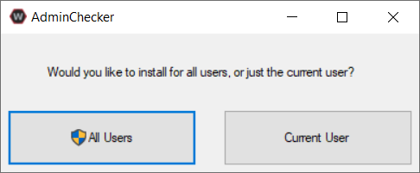
Robot Programming – Part 2
Installing Visual Studio Code
Click on All Users
Notes:
Should be able to click All Users, if not click Current User

Slide 57
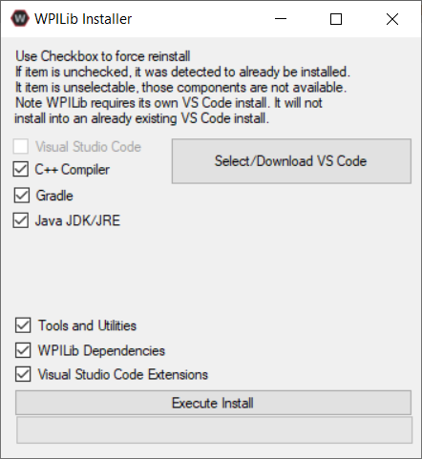

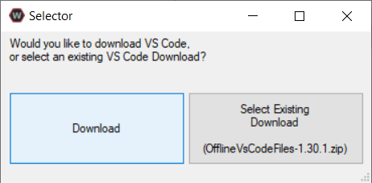
Robot Programming – Part 2
Installing Visual Studio Code
1)
2)
3)
Notes:
When they are at home they can click download, because we have the files preloaded, they can click “Select Existing download”. The file is located with the preloaded files.

Slide 58
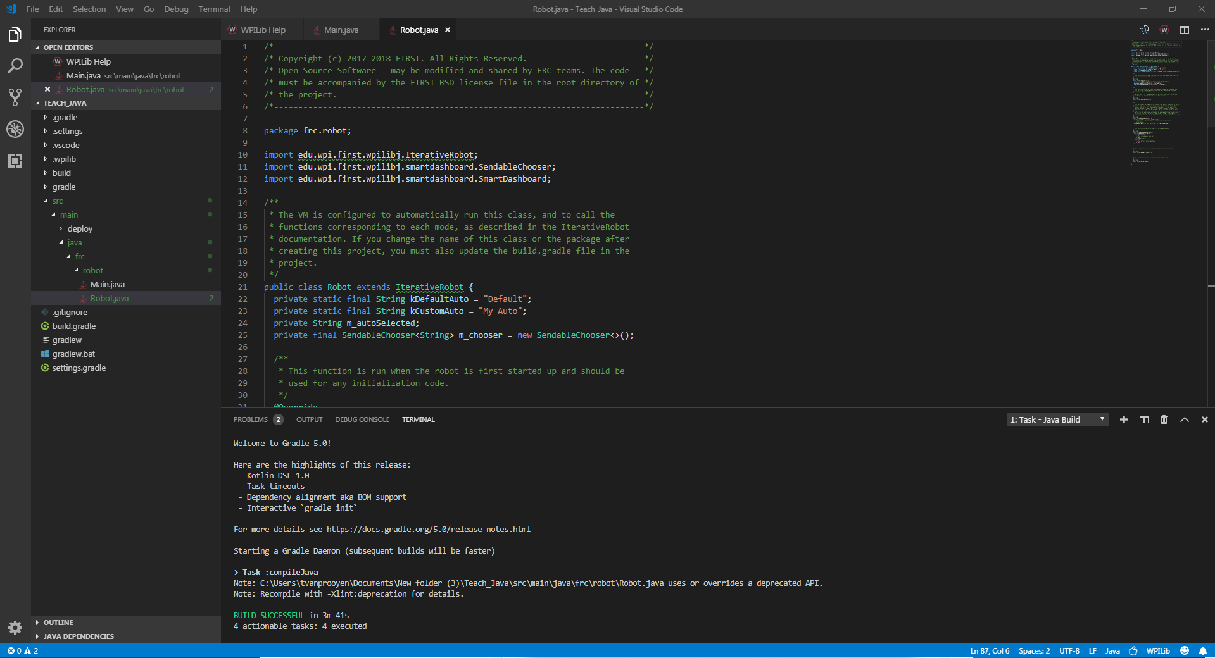
Robot Programming – Part 2
Navigating Visual Studio Code
VS code is a great software.
Able to contain multiple programming extensions
Very normal programing interface

Slide 59
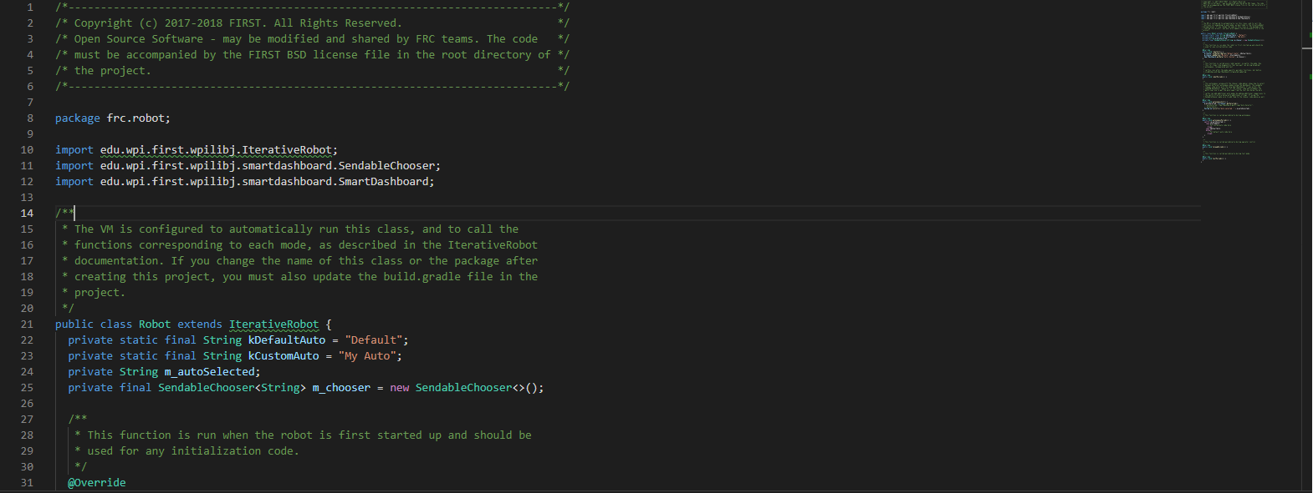
Robot Programming – Part 2
Navigating Visual Studio Code
Line Numbers are there for debugging
Automatic Syntax Notifications
Auto Color
Feature Assist
Notes:
This is the coding area. This has some nice features that come with a dedicated programming platform.
Line Numbers are there for debugging. When you have an error when building. The error will contain the Line and Column. Locate the line to fix the issue
Automatic Syntax Notifications. Anything incorrect will be underlined with yellow or red. Green underline means that something is not being called for use
Auto Color. Everything gets colored to assist with where things are and what they are
When you start typing a box will show up to give you the avaible functions that you may use. To insert press tab

Slide 60
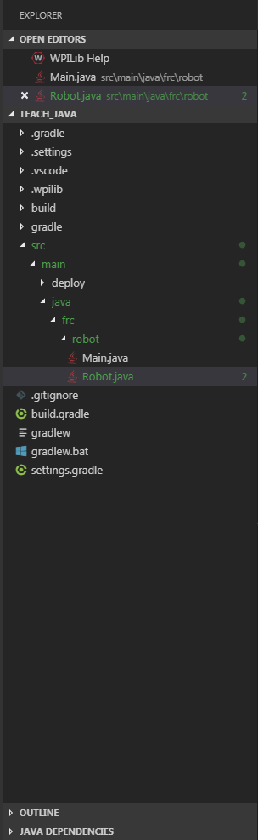
Robot Programming – Part 2
Navigating Visual Studio Code
This is the explorer. Built to give quick access to all related programming files, libraries, and builders.
It also has additional windows than can be opened on the top.

Slide 61
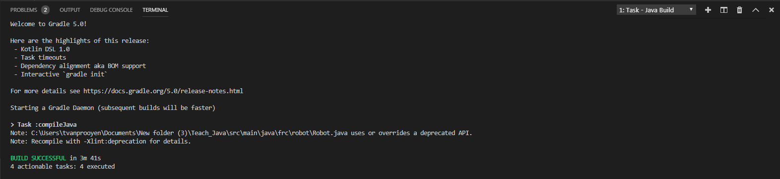
Robot Programming – Part 2
Navigating Visual Studio Code
Lets you know what the VS Code is doing.
Debugging
System.Out.Println() function posts lines here.

Slide 62
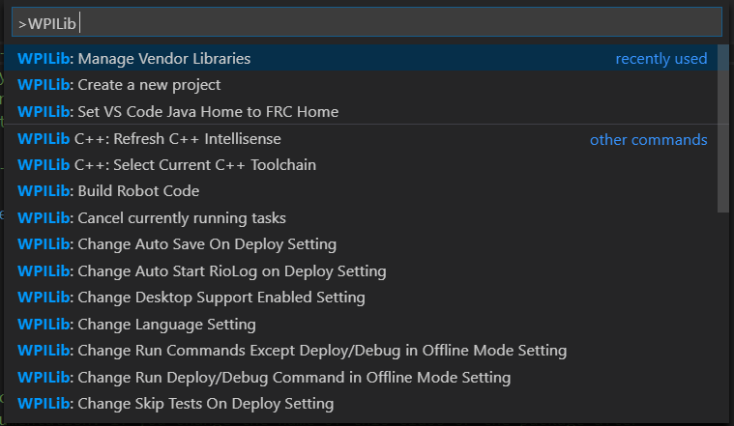
Robot Programming – Part 2
Navigating Visual Studio Code
This area is where you switch tabs and short cuts
Where you access WPI commands
Adjust window views

Slide 63
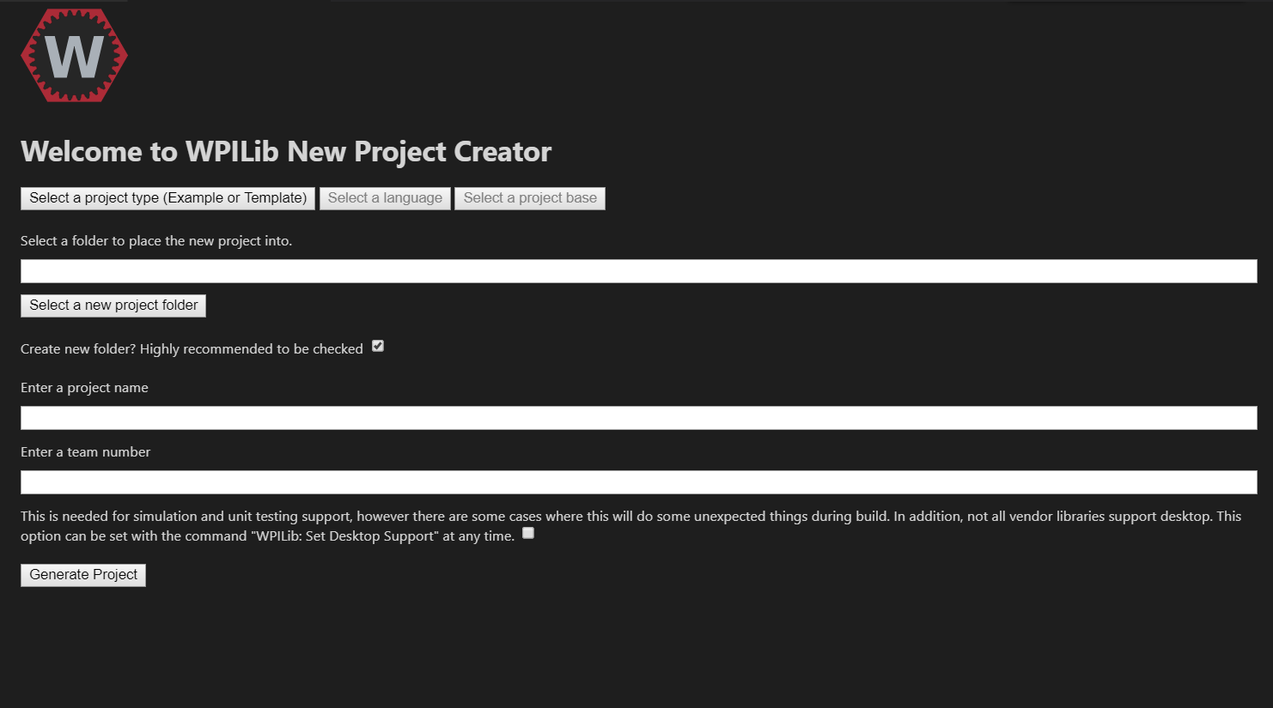

Robot Programming – Part 2
Creating a New Project
On the tab bar
Click to open commands
Type in “Create a New Project”
A new tab will open

Slide 64


Robot Programming – Part 2
Creating a New Project
Click
It should look like this at the end
Select a new project folder
Enter a project name
Enter our team number: 858
Press Generate Project

Slide 65
Robot Programming – Part 2
Robot Classes
robotInit() - This function is run when the robot is first started up and should be used for any initialization code.
robotPeriodic() - This function is called every robot packet, no matter the mode.
autonomousInit() – This function is called before autonomous is started.
autonomousPeriodic() – This function is where autonomous mode is ran.
teleopInit() - This function is called before teleop is started.
teleopPeriodic() – This function is where teleop is ran
testPeriodic() – This function is for code that needs to be tested.

Slide 66
Robot Programming – Part 2
Robot Functions (Methods)
There are hundreds of functions that are available to create a robot code. We are going to go over a few examples.
RobotDriveBase - tankDrive​(double leftSpeed, double rightSpeed)
RobotDriveBase - arcadeDrive​(double xSpeed, double zRotation)
PWM - getRaw()
DigitalInput - get()
JoyStick - getAxis​(Joystick.AxisType axis)

Slide 67
Robot Programming – Part 2
Creating our First Code
We will go over different sections of code to accomplish where to add the appropriate functions and constants.
Look above to understand what class we are working in.
Feel free to stop and ask questions. It may feel like you are just typing in random stuff, but this should help you understand the process of adding things to the robot’s code.

Slide 68
Robot Programming – Part 2
Creating our First Code – Beginning of Code, Outside of Classes
import edu.wpi.first.wpilibj.Joystick;
import edu.wpi.first.wpilibj.PWMVictorSPX;
import edu.wpi.first.wpilibj.InteractiveRobot;
import edu.wpi.first.wpilibj.drive.DifferentialDrive;
We need to import some libraries, so the code can have the functions (methods) it needs to work. Everytime you need to add functionality to the robot code you need to add the library.

Slide 69
Robot Programming – Part 2
Creating our First Code – InteractiveRobot
private DifferentialDrive m_myRobot;
private Joystick m_leftStick;
private Joystick m_rightStick;
private Spark m_leftMotor = new Spark(0);
private Spark m_rightMotor = new Spark(1);
These are all global variables. Most are definition short cuts. We do this now to relax the CPU on the roboRIO.

Slide 70
Robot Programming – Part 2
Creating our First Code – robotInit()
m_myRobot = new DifferentialDrive(m_leftMotor, m_rightMotor);
m_leftStick = new Joystick(0);
m_rightStick = new Joystick(1);
These values are now so the robot can recognize what they are for. These functions will not work outside of a robot class. You will end up with an error.

Slide 71
Robot Programming – Part 2
Creating our First Code – teleopPeriodic()
m_myRobot.tankDrive(m_leftStick.getY(), m_rightStick.getY());
After all of that we now can assign joysticks and motors to the drive type we want.

Slide 72
Robot Programming – Part 2
Creating our First Code – End Result
Look in section 5 of your papers, compare the code from there to yours. They should look the same.
It may have seemed like a lot of work to just add one line of code, but the robot needs to know where and how you are diving the robot. We will call that stuff dependencies, because they are depended upon for a line of code to work.

Slide 73
Robot Programming – Part 2
Creating our First Code – Try it your self
In this next section we need to add a motor to drive up and down with a joystick axis input. Feel free to work together to make this happen.

Slide 74
Robot Programming – Part 2
Creating our First Code – Try it your self
In this next section in your existing code we need to add a motor to drive up and down with a joystick x axis input. Feel free to work together to make this happen.
Hint: use the sparks functions.

Slide 75
Robot Programming – Part 2
Creating our First Code – Try it your self
There should have been 2 lines of code added
InteractiveRobot:
private Spark m_Motor = new Spark(2);
teleopPeriodic():
m_Motor.set(m_leftStick.getX());

Slide 76
Robot Programming – Part 2
Building/Deploying Robot Code
On the tab bar
Click to open commands
Type in “Build Robot Code”

Slide 77
Robot Programming – Part 2
WPI Library Reference
Every function (method) and class is described how it works at this link: https://first.wpi.edu/FRC/roborio/release/docs/java/

Slide 78
Project Management
How we keep track of code
Debugging

Slide 79
Project Management
How we keep track of code
When we have multiple people working on a code. We need to have a structure on how the code is formed in to a cohesive project.
We have standards for how constants are called and how code is preformed.

